Slide 1
IST 707: DATA MINING
Unit 1 Introduction

Slide 2
AGENDA
Introductions
Review Syllabus
Overview of concepts we will study this semester

Slide 3
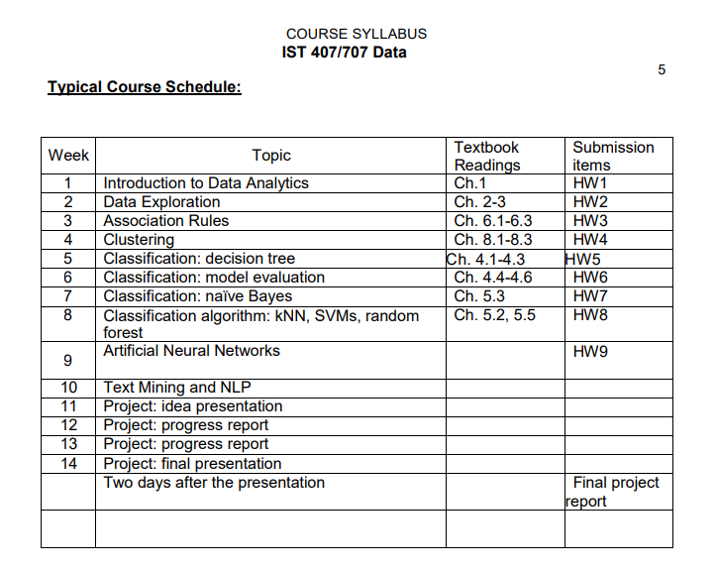
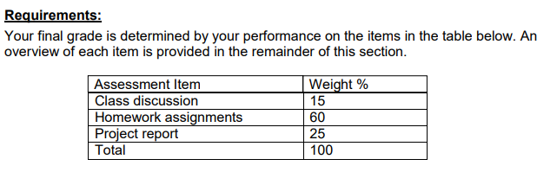

Slide 4

WHAT IS DATA MINING?
Data mining is the process of discovering patterns in large data sets involving methods at the intersection of machine learning, statistics, and database systems. (Wikipedia)
Data mining is an interdisciplinary subfield of computer science and statistics with an overall goal to extract information (with intelligent methods) from a data set and transform the information into a comprehensible structure for further use (Wikipedia)
“Non-trivial extraction of implicit, previously unknown and potentially useful information from data” - Gregory Piatetsky-Shapiro, founder of kdnuggets.com
Notes:
Data Mining was initially called as KDD (Knowledge discovery in databases)
Counting how many men and women in the room?
Can be one step in a data mining task, like?

Slide 5
WHERE ARE DATA MINING TECHNIQUES USED
Data Mining in Finance
Collecting and analyzing customer behavior data helps banks identify risks and launch relevant services and products.
Identifies fraudulent or non-fraudulent transactions.
Data Mining in Healthcare
Identify high risk patients for special services.
Discovers the relationships between diseases and the effectiveness of treatments.
Data Mining in Telecommunication
Reduce customer churn by understanding demographic characteristics and predicting customer behavior.
https://data-flair.training/blogs/data-mining-applications/

Slide 6
WHERE ARE DATA MINING TECHNIQUES USED
Data Mining in Marketing and Sales
Perform market basket analysis to provide information on what product combinations have to purchased together. This information helps businesses promote their most profitable products and maximize the profit.
Data Mining in E-commerce
Many E-commerce companies are using data mining to offer cross-sells through their websites. One of the most famous of these is, of course, Amazon. They use sophisticated mining techniques to drive their ‘People who viewed that product. Also liked this’ functionality.
Data Mining in Retail
Generally, retailers segment customers into ‘Recency, Frequency, Monetary’ groups. They then target marketing and promotions to those different groups.
Large retailers like Walmart utilize information on store footfall, advertising campaign even weather forecast to predict sales and stock up accordingly.
https://data-flair.training/blogs/data-mining-applications/
Notes:
Data Mining in Marketing and Sales – Association Rule mining
Data Mining in E-commerce – Recommendation System
RFM Value is a marketing analysis tool used to identify companies' best customers by measuring and analyzing spending habits.
Recency: How recently a customer has made a purchase
Frequency: How often a customer makes a purchase
Monetary Value: How much money a customer spends on purchases

Slide 7
TYPICAL DATA MINING TASKS
Classification
Clustering
Association rule mining
Notes:
All Machine Learning models can be categorized as:
Supervised Learning -
We are given a data set and already know what should be the outcome variable (We already know input and output). We use this data like a training dataset to train the model.
Example: "regression" and "classification" problems.
In a regression problem, we are trying to predict results within a continuous output -> we are trying to map input variables to some continuous function.
In a classification problem, we are instead trying to predict results in a discrete output -> we are trying to map input variables into discrete categories.
Unsupervised Learning - input information isn’t marked and doesn’t have a known outcome. There is no outcome or target variable that needs to be predicted. Used to find pattern in the data without having outcome variables.
Example – Clustering, Dimensionality Reduction

Slide 8
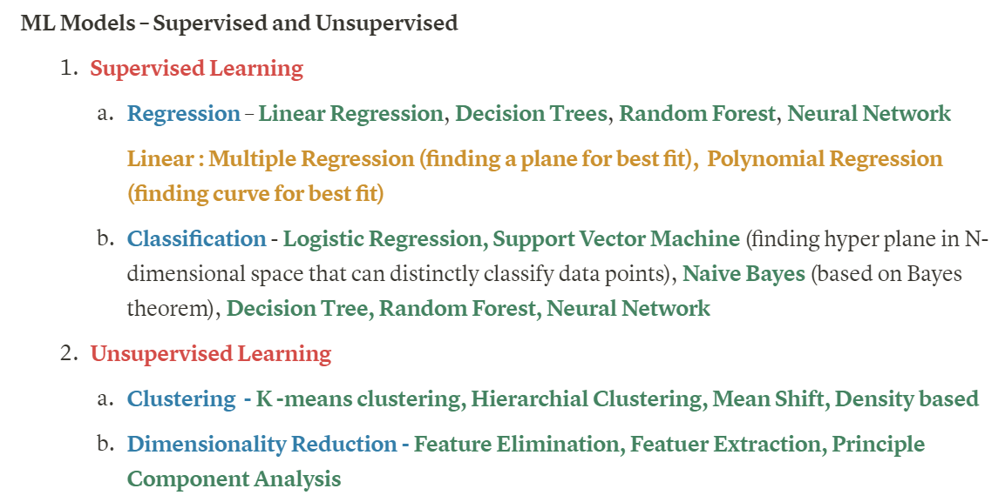
All Machine Learning Models

Slide 9
CLASSIFICATION

Slide 10

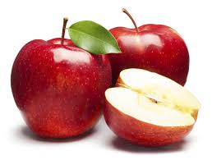
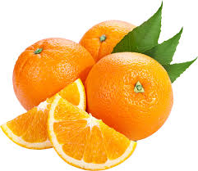

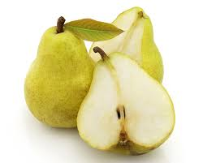
WHAT IS CLASSIFICATION?
Given some pre-defined categories, assign objects to one or more categories
Is this fruit apple, orange, strawberry, or pear?
Classification is usually done as a type of supervised machine learning
?
Notes:
The classification problem is just like the regression problem, except that the values that we want to predict take on only a small number of discrete values.

Slide 11
Classification vs. Regression
The prediction output is different
Classification outputs categorical decisions (e.g. spam or regular emails)
Use machine learning techniques
Taught in this class
Regression outputs numeric values (e.g. stock price, temperature)
Use regression techniques
Taught in statistics class
Notes:
Some people might ask, the email spam filter predicts which emails are spams. What is the relationship between prediction and classification? Actually classification is a kind of prediction. There are two kinds of predictions: classification and regression.

Slide 12
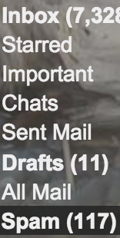
CLASSIFICATION IN EVERYDAY LIFE
Gmail identifies spam emails from regular ones.
Gmail categorizes regular emails into Primary, Social, Promotion, Updates, etc.
Notes:
Here is an application of classification in our everyday life. Everybody uses emails. Gmail can identify spam emails from regular ones. Email spam filtering is a classification task because two categories are pre-defined, spam or not spam, and the spam filter decides for each incoming email whether it’s spam or not.
Also talk about social aspect of data mining, especially user need and workload, like overburden user if important emails were separated into primary and updates, users might neglect some important emails

Slide 13
EXERCISE: FIND CLASSIFICATION APPLICATIONS IN EVERYDAY LIFE
Can you describe any classification applications that you have used besides spam email filter?

Slide 14
HOW TO MODEL A CLASSIFICATION PROBLEM?
Bank loan approval:
What is the decision to make?
What is the unit of analysis?
What attributes are helpful for classification?
Notes:
Let’s use a case study to learn how to model a classification problem? This is a case of bank loan prediction. Imagine a bank needs to decide whether to approve or deny a loan application.

Slide 15
WHAT IS THE DECISION TO MAKE?
What is the decision to make?
“Approve” or “deny” a loan application
The decision is saved in the target attribute

Slide 16
WHAT IS THE UNIT OF ANALYSIS?
The unit of analysis means an example in your data set. A classification decision will be made for each example.
For bank loan classification, an individual application is an example, which will be either approved or denied.
Individual person may not be good unit of analysis, because one person may submit multiple applications over time, and each deserves a separate decision.

Slide 17
WHAT ATTRIBUTES ARE HELPFUL FOR CLASSIFICATION?
What attributes are useful for classification?
Potentially useful attributes
e.g. applicant’s age, job title, income, credit score, amount requested, etc.
Some might be more useful than others
Classification algorithms can rank the attributes by their contribution to classification (Variable Importance)

Slide 18
SAMPLE DATA FOR BANK LOAN CLASSIFICATION
application | Job title | Income | Credit score | decision
1 | teacher | 50K | 700 | approve
2 | manager | 60K | 300 | deny
Each row is an example.
Each column is an attribute.
The last attribute is the decision to make, the target attribute.
Notes:
After you modeled a problem as a classification task, you should be able to envision a sample data set like this.

Slide 19
HOW TO TEACH A COMPUTER TO CLASSIFY?
Step 1: collect training data.
E.g., a collection of past loan decisions made by financial experts
Step 2: Use a machine learning algorithm to build a classifier based on relevant variables
Step 3: Apply the classifier to new data.

Slide 20
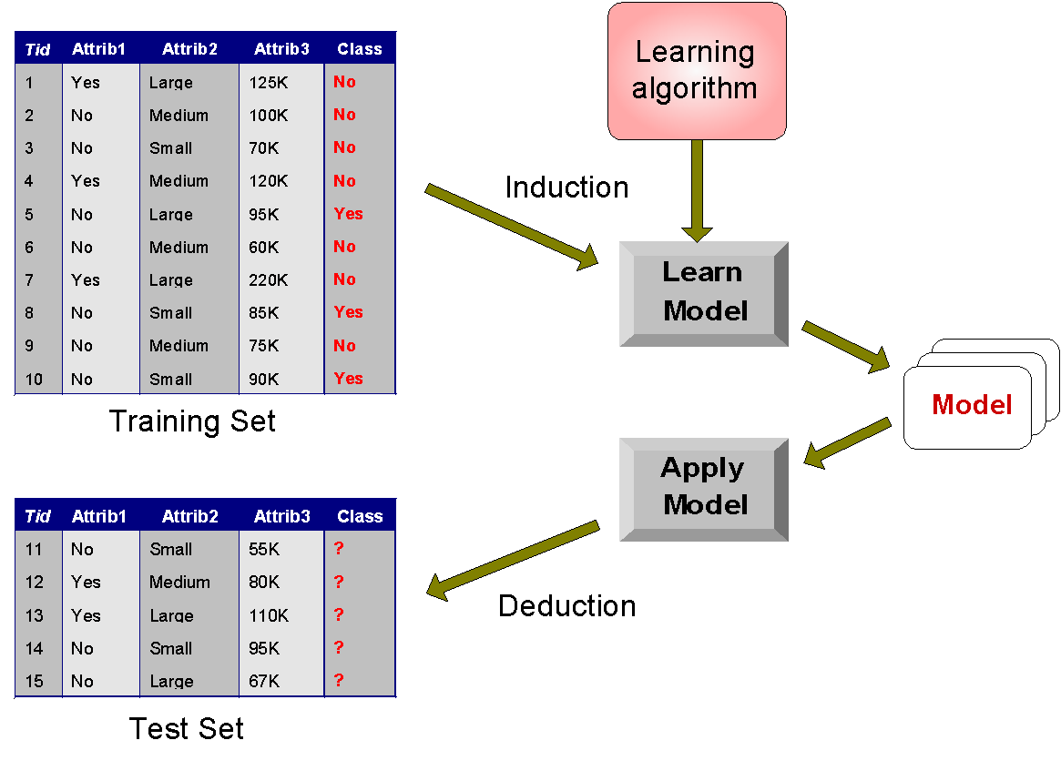
ILLUSTRATING CLASSIFICATION TASK
Two steps

Slide 21
ARE WE DONE?
No. Prediction models need maintenance.
What if an approved loan defected?
Add defective loans to the deny pool and retrain the model.
What if a denied application was approved by another bank and performed well?
No good solution without data sharing.
Notes:
For certain tasks Pre-trained models can be used for tasks like image recognition, speech recognition etc.
If you use speech prompted gadgets like Amazon echo or Google home, they will ask you if the response was correct or not, and your feedback will be used to retrain the model.
Of course models need re-training

Slide 22
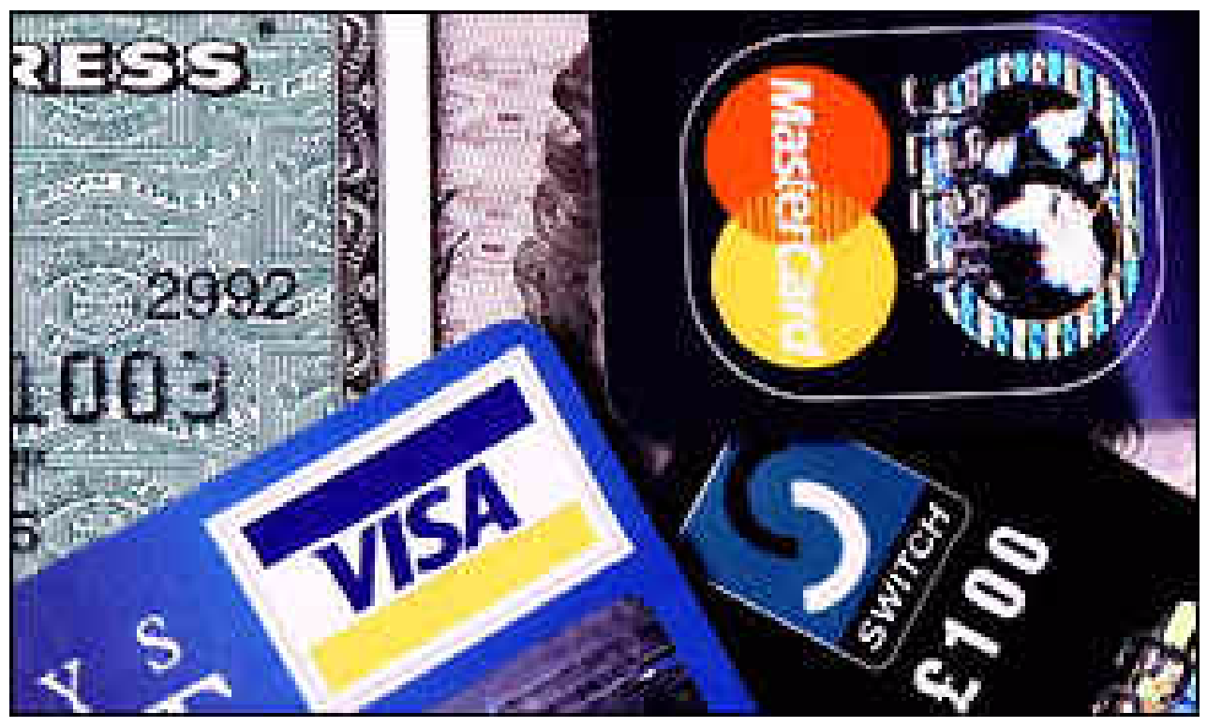
ANOMALY DETECTION (outlier)
Detect significant deviations from normal behavior
Applications:
Credit Card Fraud Detection
Network Intrusion Detection
Can be modeled as classification problem
Classify each transaction as fraud or not

Slide 23
EXERCISE: MODEL A CLASSIFICATION PROBLEM
Can you model a classification problem?
What is the decision to make (target attribute)?
What is the unit of analysis (example)?
What attributes may be helpful for classification?
If you can’t think of any, check out the tasks in Kaggle competitions and see if there is any classification task
https://www.kaggle.com/competitions
Notes:
Now that we learned the definition of classification task and how to model it, can you model a classification problem?
If you can’t think of any, check out the tasks in Kaggle competitions and see if there is any classification tasks
https://www.kaggle.com/competitions
Ask everyone to group up and identify three interesting classification tasks. 10 minutes?

Slide 24
CLUSTERING

Slide 25
CLUSTERING
Given a set of data points, each having a set of attributes, and a similarity measure among them, find clusters such that
Data points in one cluster are more similar to one another.
Data points in separate clusters are less similar to one another.
Clustering is a type of unsupervised machine learning
Intra cluster distances
are minimized
Inter cluster distances
are maximized

Slide 26
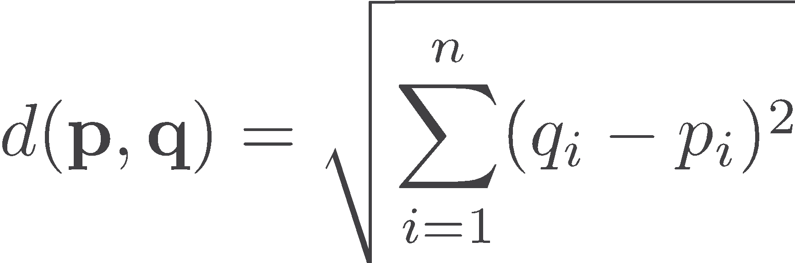
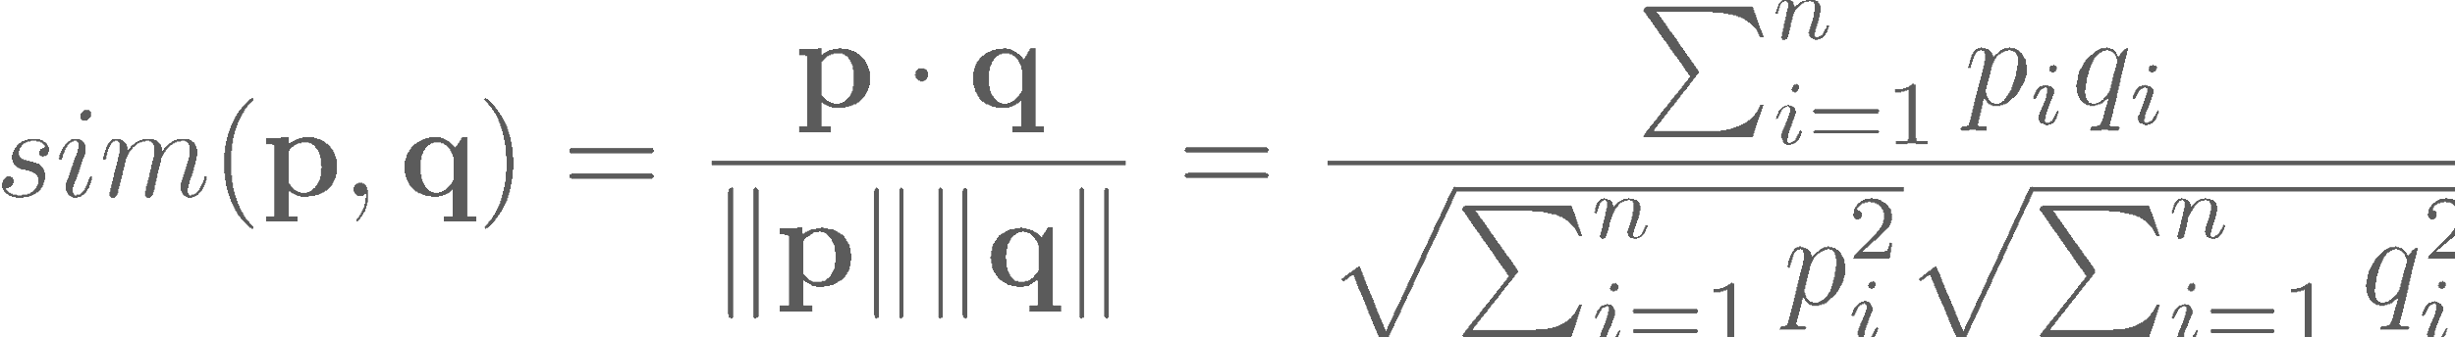
SIMILARITY MEASURES FOR CLUSTERING
Similarity Measures:
Euclidean Distance if attributes are continuous.
Cosine similarity in some text mining applications.
Other Problem-specific Measures.
Notes:
Euclidean distance:

Slide 27
CLUSTERING APPLICATION 1
Market / Customer segmentation:
Goal: to find the “subgroups” among a large customer base.
Approach:
collect some “attributes” about the customers, like their age, income, favorite brands, etc.
Calculate the “similarity” between the customers
“cluster” similar customers together

Slide 28
WHAT DOES A CLUSTER MEAN?
Although clustering algorithm can group/cluster similar customers together, it does not tell us what each cluster means.
Data analysts need to understand and interpret the meaning of clusters, e.g. one cluster may be interpreted as “tree huggers”, or “ money savers”, “luxury fans”, etc.

Slide 29
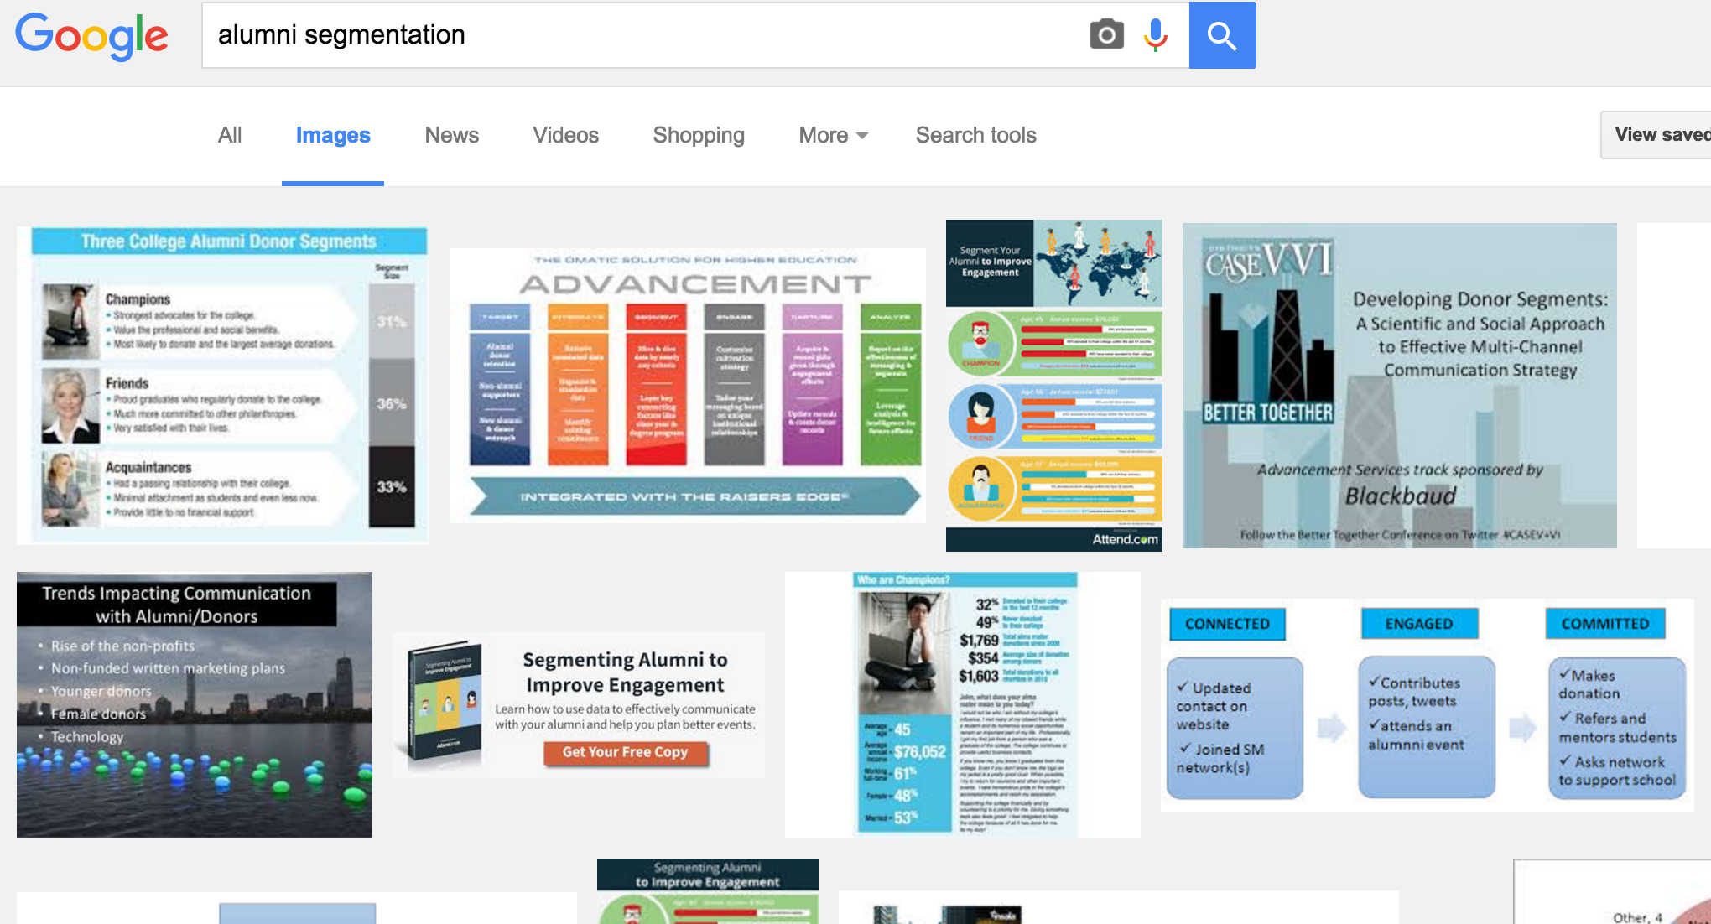
WHAT DOES A CLUSTER MEAN?

Slide 30
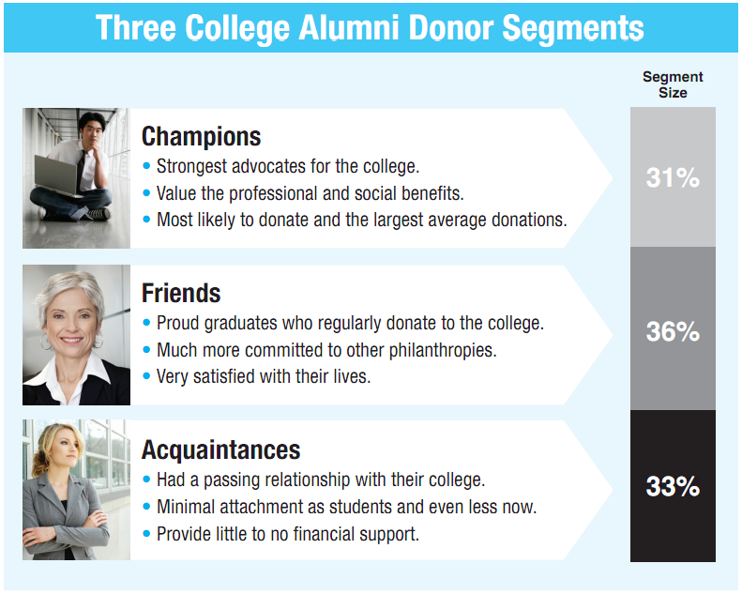

Slide 31
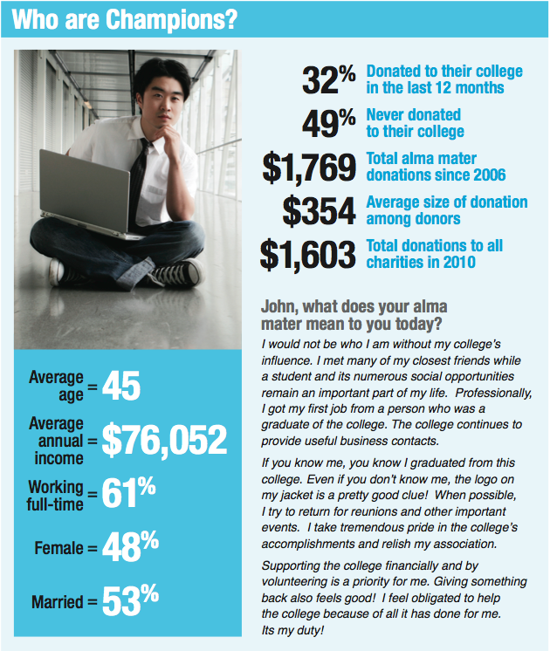

Slide 32
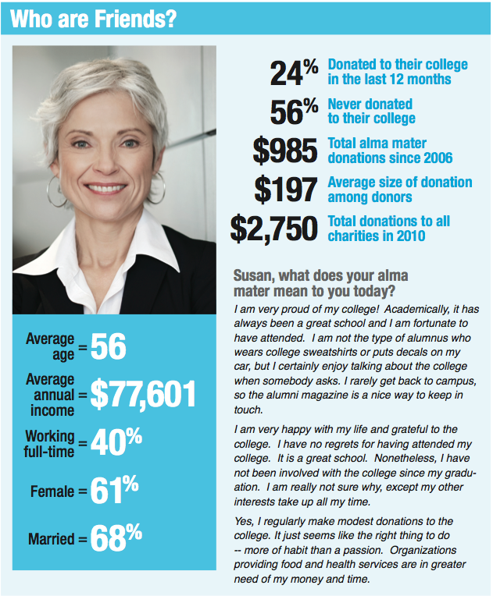

Slide 33
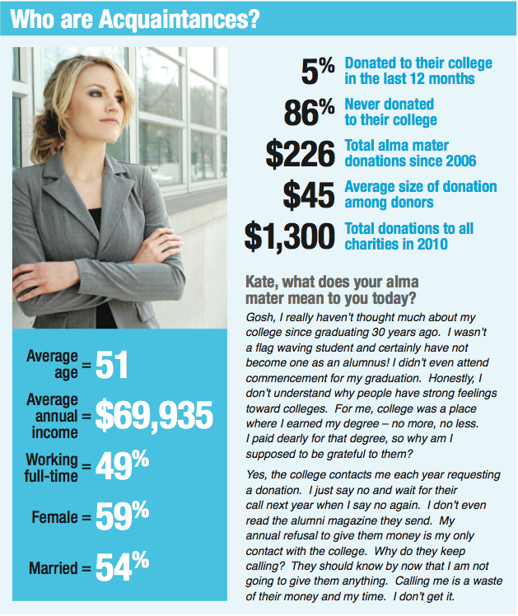

Slide 34
DISCUSSION QUESTION
If you were managing a fund-raising campaign: Would you send the same messaging to each group?
Why or why not?
If different, how ?

Slide 35
CLUSTERING: APPLICATION 2
Document Clustering:
Goal: To find groups of documents that are similar to each other based on the important terms appearing in them.
Approach: To identify frequently occurring terms in each document. Form a similarity measure based on the frequencies of different terms. Use it to cluster.
Gain: Search engines can organize search results by document clusters.
https://news.google.com/

Slide 36
SEARCH ENGINE BASED ON DOCUMENT CLUSTERING
http://search.carrot2.org/
Search “Amazon” and see the returned results organized into clusters with labels
The pioneer clustering-based search engine “clusty” was sold to Yippy, Inc.

Slide 37
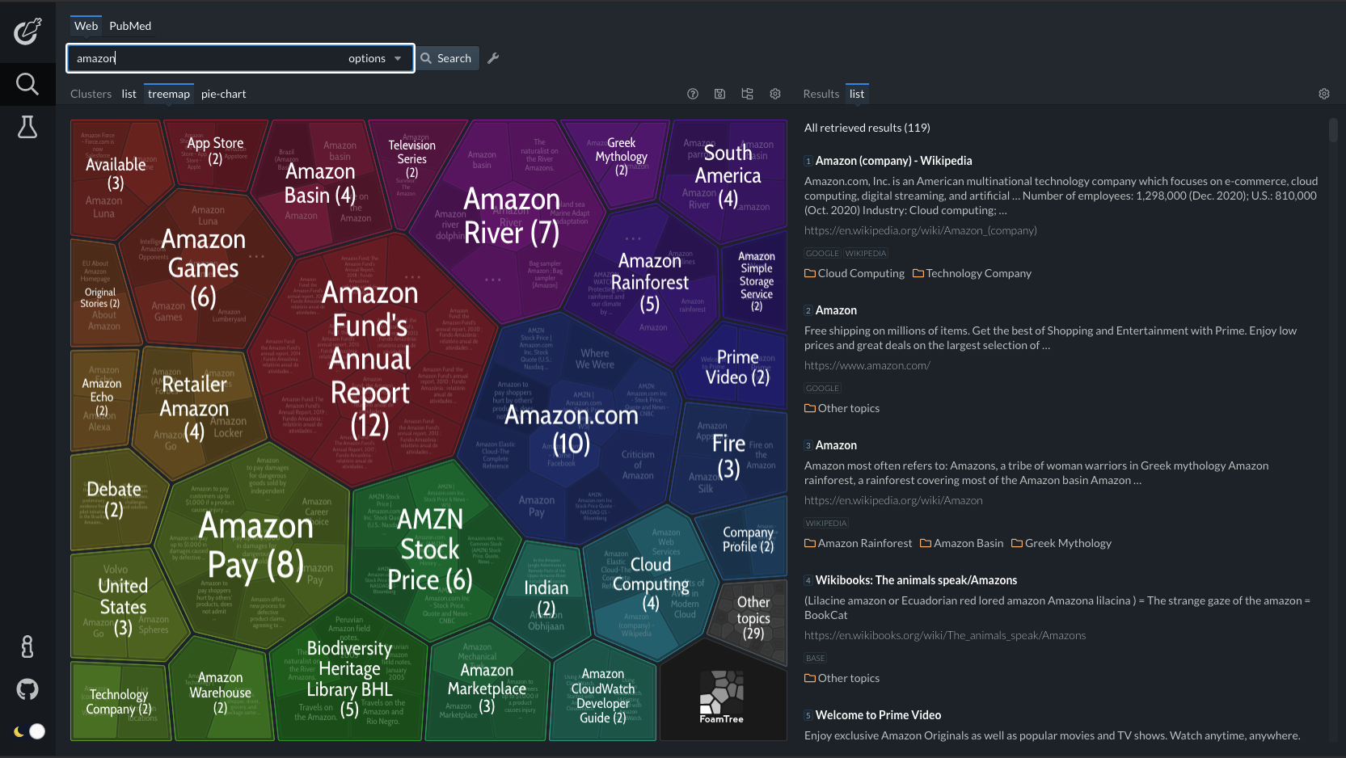
CARROT2 SEARCH ENGINE BASED ON DOCUMENT CLUSTERING

Slide 38
CLASSIFICATION VS. CLUSTERING
Classification: supervised learning
Clustering: unsupervised learning
No training data.
No pre-defined target variable.
more suitable for exploratory analysis for data sets that we don’t know much about

Slide 39
CAN A CLUSTERING AND CLASSIFICATION BE USED TOGETHER ?
Yes, sometimes serve as the first step, to define the categories
E.g. after a customer base is clustered into three clusters, we can examine these clusters and “label” them as “tree huggers”, “savers”, and “luxury fans” categories
Given a new customer, we can predict which cluster this customer belongs to, based on his/her similarity with the members in each cluster.

Slide 40
EXERCISE: MODEL A CLUSTERING TASK
Describe a useful application in which clustering techniques can be used for pattern discovery and prediction.
Notes:
Group in teams of 2 / 3 – work for ten minutes, report out

Slide 41
ASSOCIATION RULE MINING

Slide 42
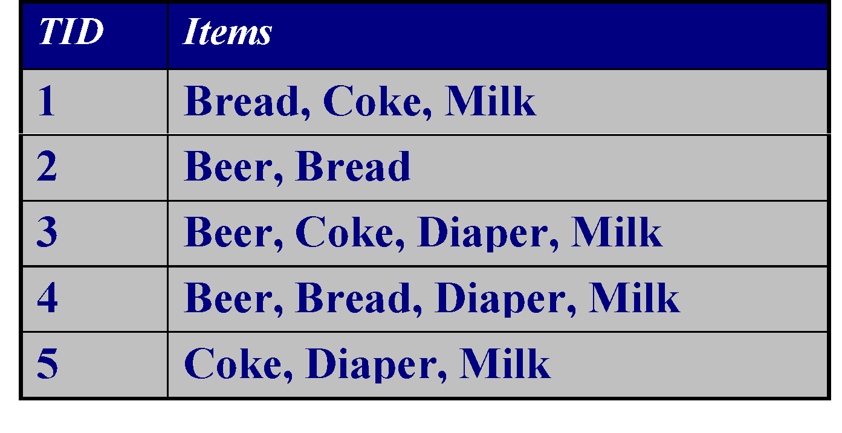
ASSOCIATION RULE MINING
Given a set of transactions, find
items that co-occur frequently
rules like “if a customer bought x, he or she would buy y too”
Strong rules
{Milk} --> {Coke}
{Diaper, Milk} --> {Beer}

Slide 43
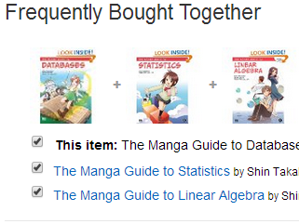
FREQUENT ITEMSETS
Itemset
a collection of one or more items
k-itemset contains k items
1-itemset:
{A}:3, {B}:3, {C}:2, {D}:4, {E}:3, {F}:2
2-itemset:
{A,B}:1; {A,D}:3
3-itemset:
{A,B,C}:0; {B,E,F}=2
Transaction-id | Items bought
10 | A, B, D
20 | A, C, D
30 | A, D, E
40 | B, E, F
50 | B, C, D, E, F

Slide 44
ASSOCIATION RULES
Association Rule
an implication of the form X 🡪 Y,
where X and Y are itemsets,
e.g. { E, F } 🡪 { B }
Example Rules:
{B, E} 🡪 {F}
{E, F} 🡪 {B}
{B, F} 🡪 {E}
{B} 🡪 {E, F}
{E} 🡪 {B, F}
{F} 🡪 {B, E}
Transaction-id | Items bought
10 | A, B, D
20 | A, C, D
30 | A, D, E
40 | B, E, F
50 | B, C, D, E, F
LHS:
Left-Hand Side
RHS:
Right-Hand Side

Slide 45
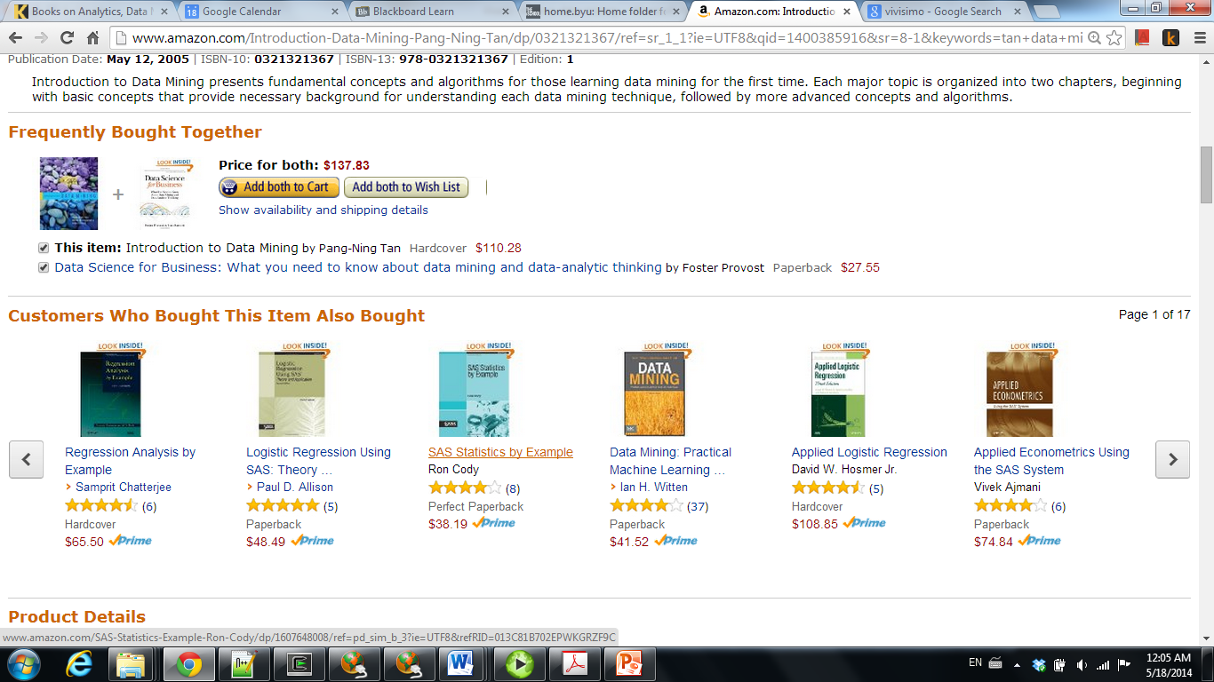
AR MINING APPLICATION 1: MARKETING AND SALES PROMOTION

Slide 46
AR MINING APPLICATION 2: SHELF MANAGEMENT
Supermarket shelf management.
Goal: To identify items that are bought together by sufficiently many customers.
Approach: Process the point-of-sale data collected with barcode scanners to find dependencies among items.
A classic rule --
If a customer buys diaper and milk, then he is very likely to buy beer.
So, don’t be surprised if you find six-packs stacked next to diapers!

Slide 47
AR MINING APPLICATION 3: INVENTORY MANAGEMENT
Inventory Management:
Goal: A consumer appliance repair company wants to anticipate the nature of repairs on its consumer products and keep the service vehicles equipped with right parts to reduce on number of visits to consumer households.
Approach: Process the data on tools and parts required in previous repairs at different consumer locations and discover the co-occurrence patterns.

Slide 48
EXERCISE: MODEL AN AR MINING TASK
Describe a useful application in which association rule mining techniques can be used for pattern discovery and prediction.
Notes:
Groups of 3 – 10 minutes

Slide 49
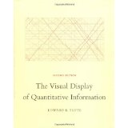
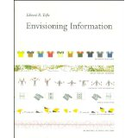
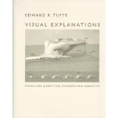
HOW TO IMPROVE DATA STORY TELLING SKILLS?
Some general data science books may be fun to read and can improve your data story telling skills, such as Edward Tufte’s books on data presentation and visualization

